Slide 1
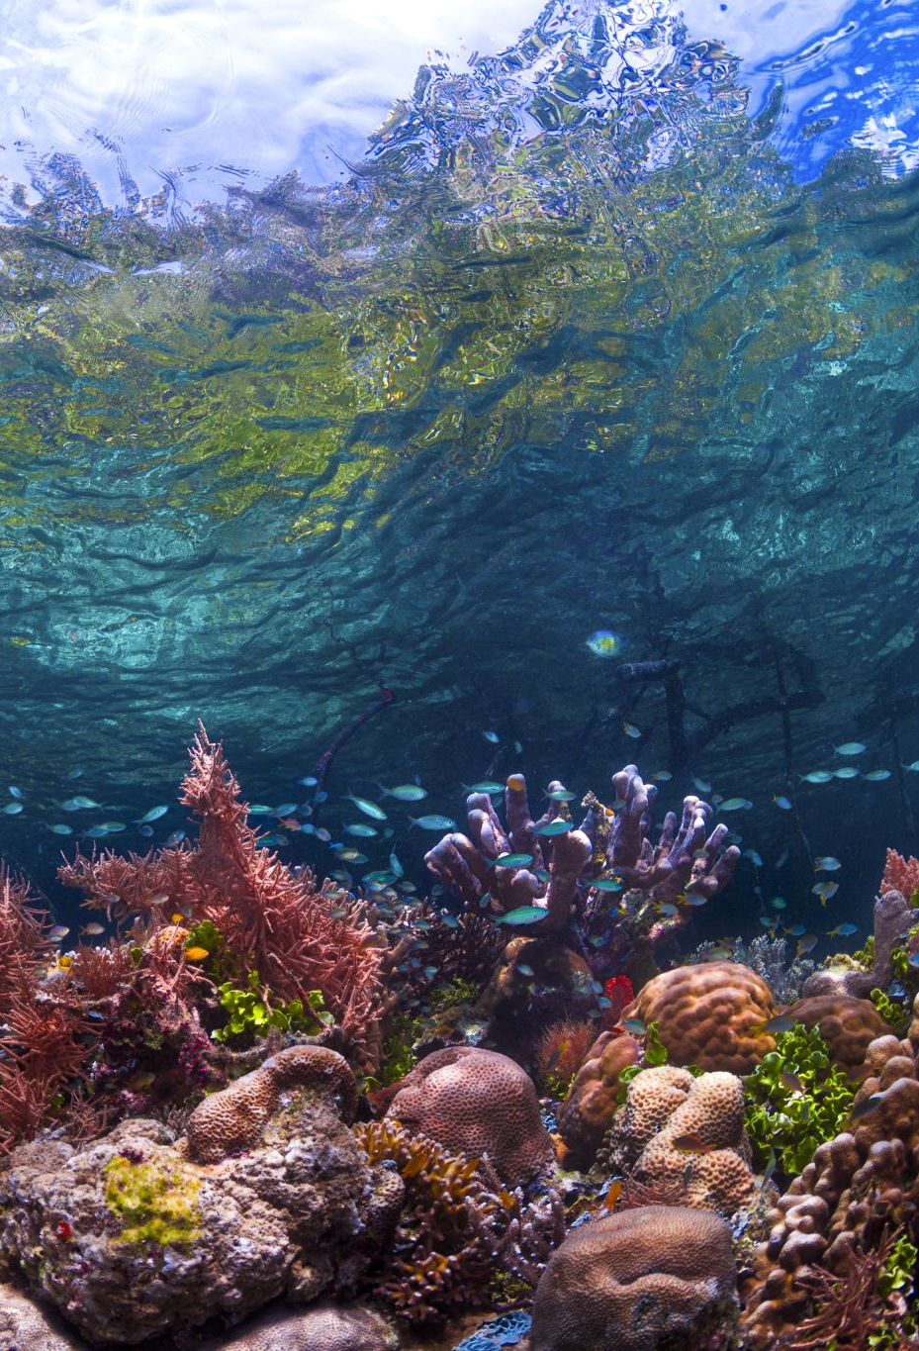



Improving habitat suitability models to understand how Mesophotic Coral Reef distribution will respond to climate change
Philip Yang (philip_yang@uri.edu), PhD student, Biological Oceanography
Mentor: Prof. Andrew Davies (davies@uri.edu)
21 June 2024

Slide 2
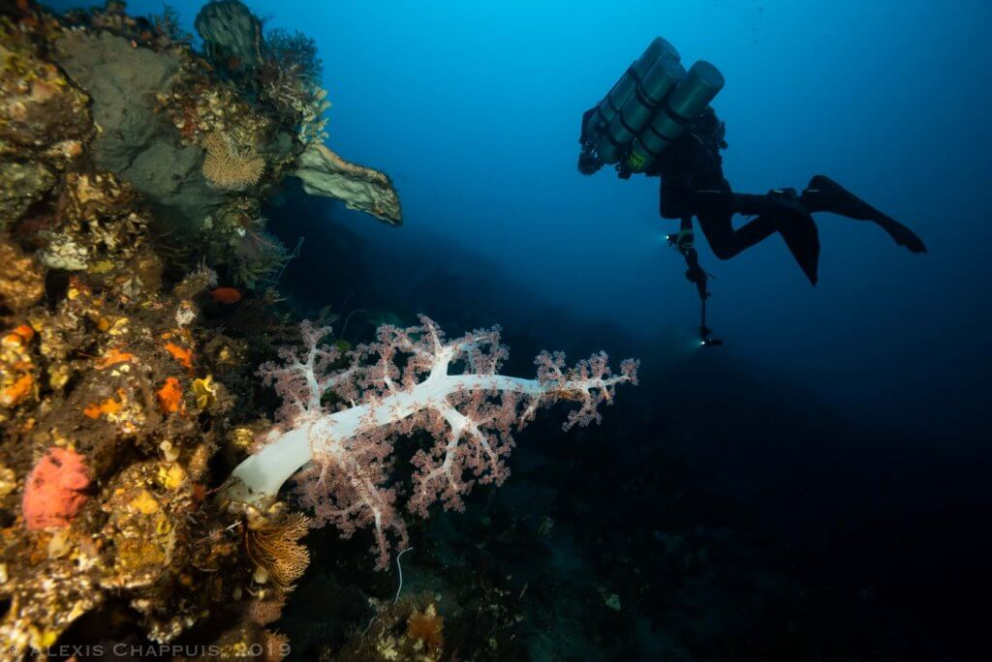
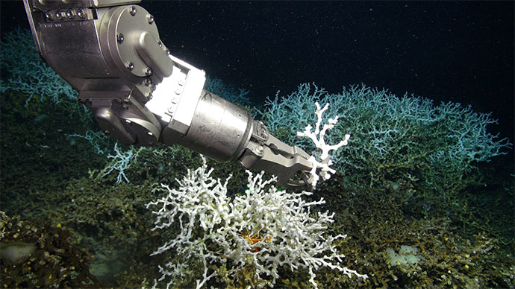
Mesophotic reefs: 30 m – 150 m: 80% of coral reef habitat
Autotrophy
0
-500
-1000
-2000
Shallow-water coral
.
Heterotrophy
NSF LTER, Moorea
.
Mesophotic coral
.
Depth (m)
Alexis Chappuis, Indonesia
Deep-sea coral
.
Middle child!
NOAA OER
.
Pyle and Copus 2019
Notes:
https://lternet.edu/stories/deep-sea-diving-on-shallow-reefs/

Slide 3
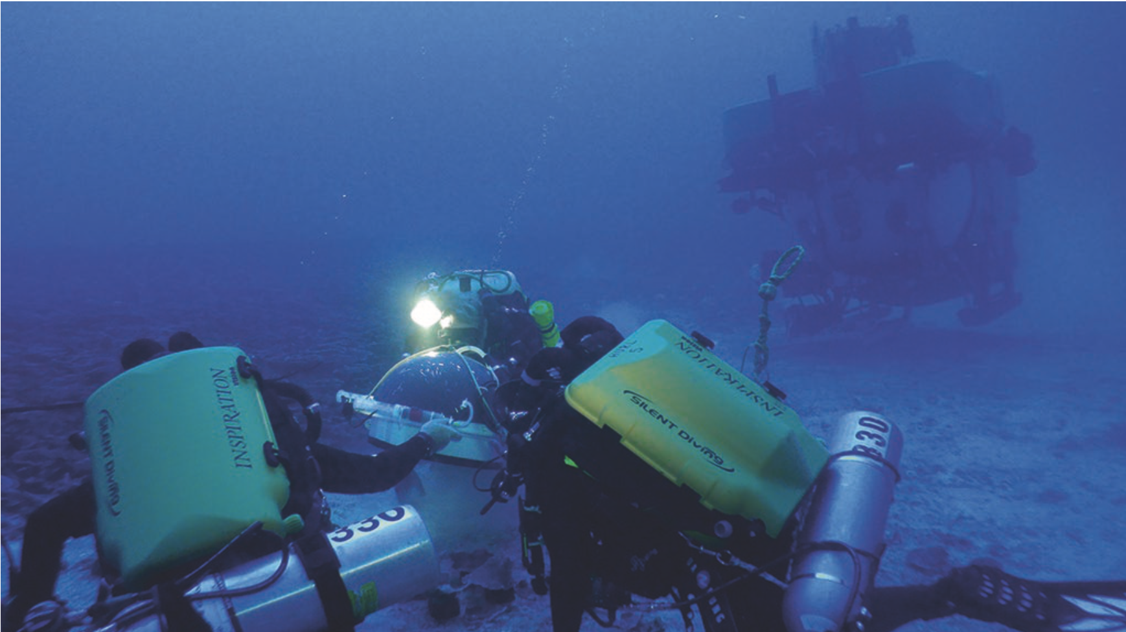
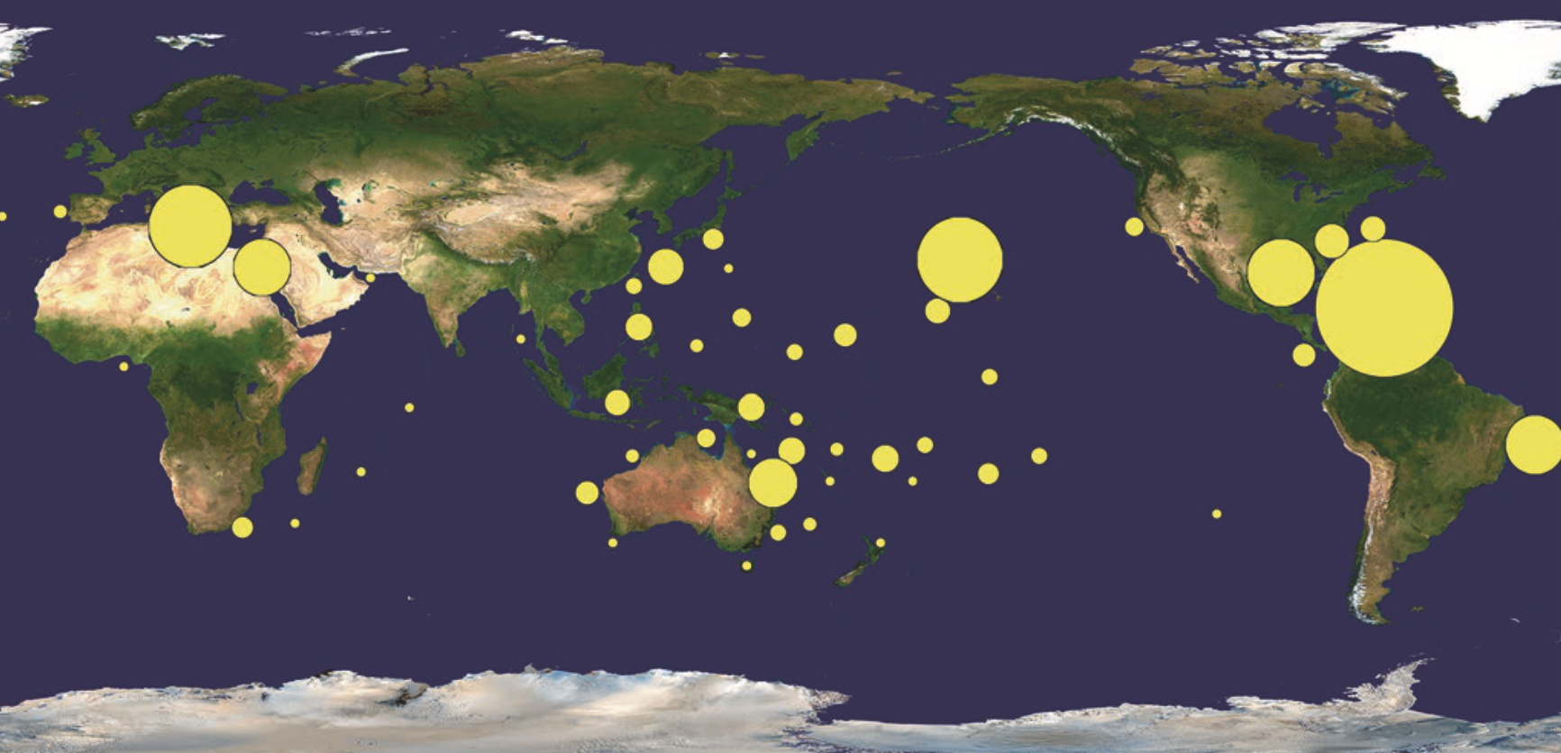
209
Rebreather, Pisces IV, Hawaii
.
1
Pyle and Copus 2019
Studying distribution is difficult:
Costly (ship and crew)
Time-intensive
Specialized (technical divers, robotic vehicles)

Slide 4
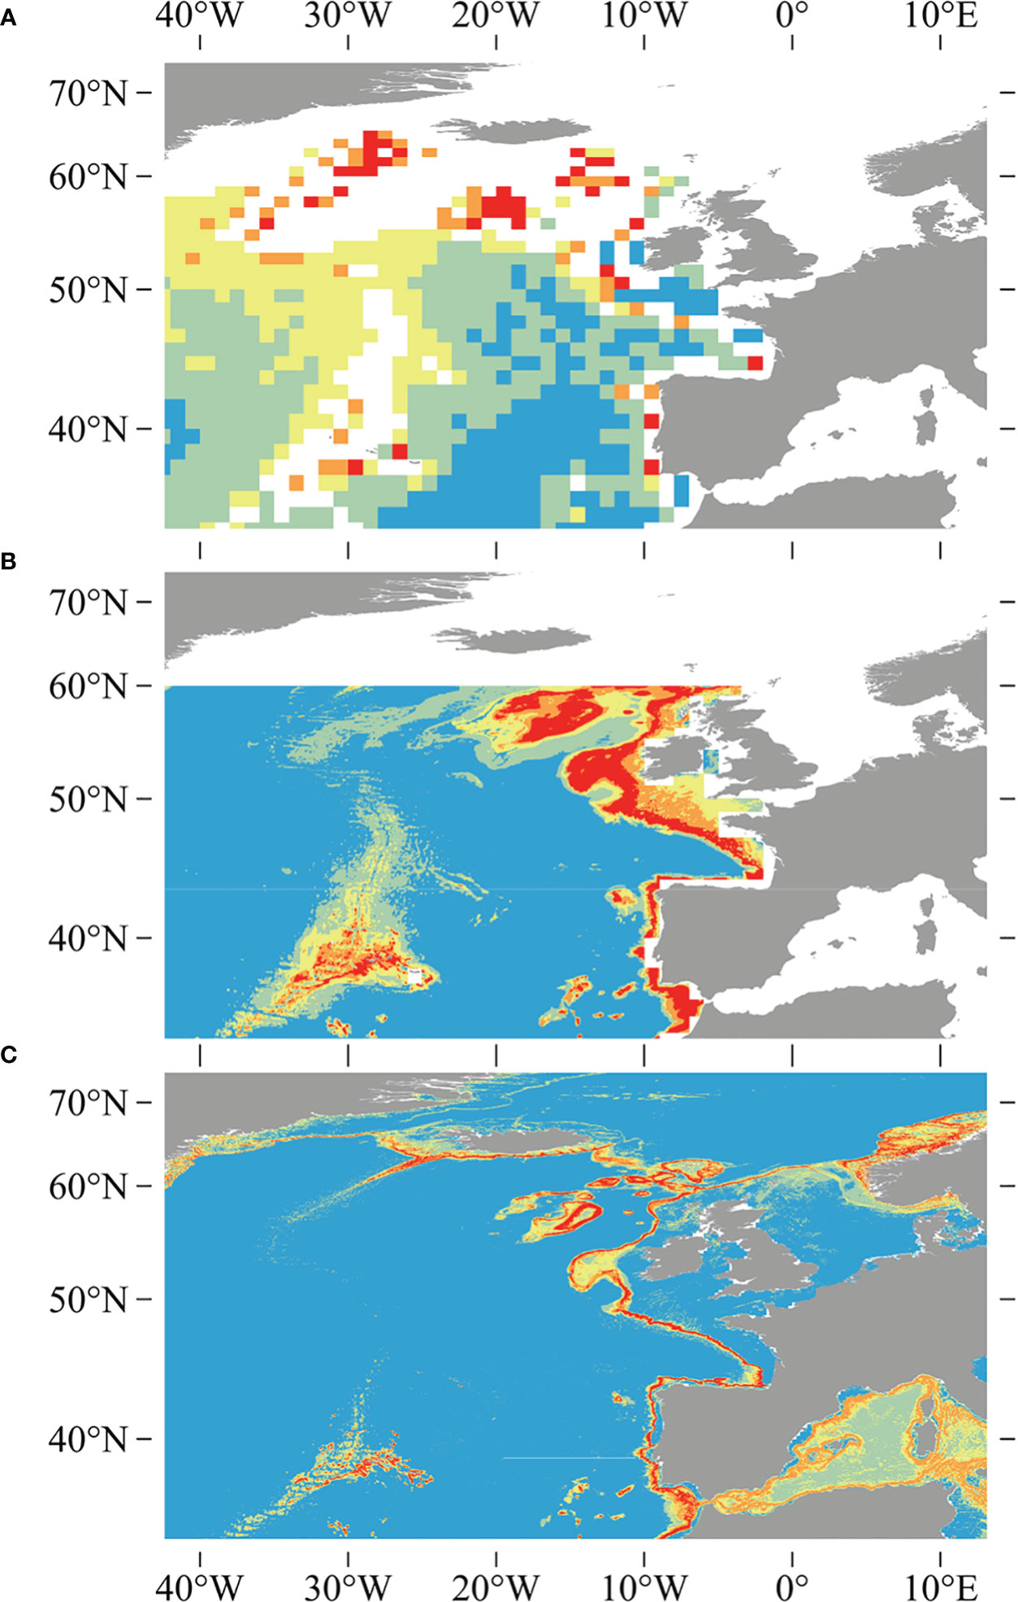
Improving habitat suitability models to understand how Mesophotic Coral Reef distribution will respond to climate change
Habitat suitability models = predict places habitat COULD be based a suite of environmental factors: cost effective!!
The difference between a model for Desmophyllum pertusa over time.
(A) Davies et al. 2008
(B) Davies and Guinotte 2011
(C) Tong et al. 2023
Tong et al. 2023

Slide 5
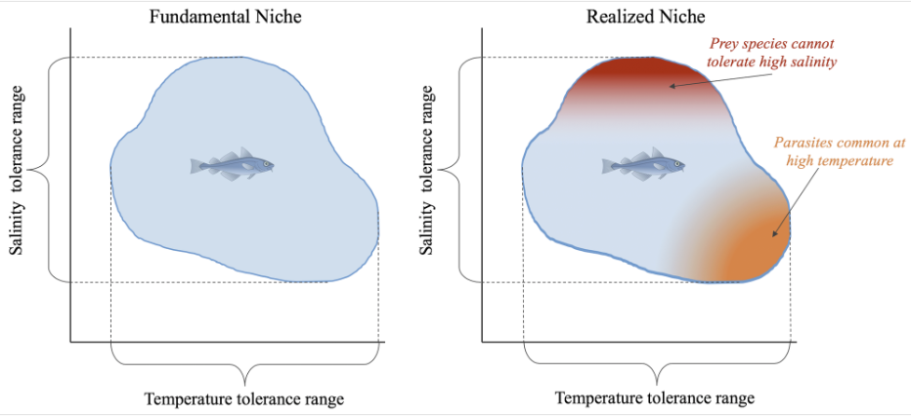
Improving habitat suitability models to understand how Mesophotic Coral Reef distribution will respond to climate change
Habitat suitability models = predict places habitat COULD be based a suite of factors
Based on ecological niche theory
Gerhart-Barley UC Davis LibreTexts
Intro to Biology

Slide 6
Improving habitat suitability models to understand how Mesophotic Coral Reef distribution will respond to climate change
Habitat suitability models = predict places habitat COULD be based a suite of factors
Based on niche theory
Requires many parts and steps
Model run (Unity computer cluster through URI using OpenOnDemand and Slurm jobs)
Model script (R and Rstudio, we used MaxEnt model)
Process Data (ArcPy in Python, R)
Data (environmental and habitat or species locations)

Slide 7

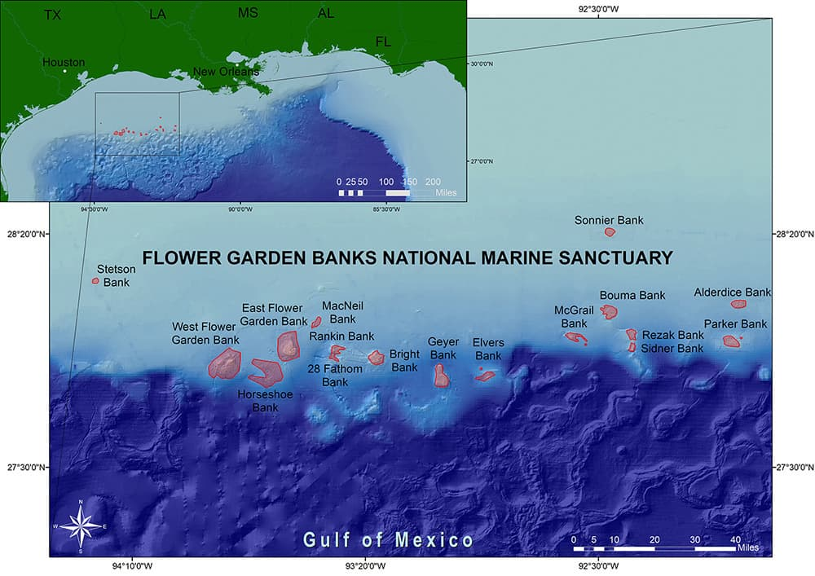
Improving habitat suitability models to understand how Mesophotic Coral Reef distribution will respond to climate change
Goal: Build a habitat suitability model for high-resolution multibeam bathymetry (5 m) at Flower Garden Banks National Marine Sanctuary
Interested in seeing how high-resolution suitability models compare with lower-resolution ones (Sterne et al. 2020).
NOAA FGBNMS

Slide 8
Improving habitat suitability models to understand how Mesophotic Coral Reef distribution will respond to climate change
Time frame
Start: 1 Jan 2024
End: 30 June 2024
Month | Jan | Feb | Mar | Apr | May | Jun
Goals | - Launch Presentation - Start collecting and organizing data - File structure - Choose the types of models appropriate for the data type | - Build environmental layers; particularly high resolution multibeam for bathymetry - Cont. with data collection | - Combine all inputs and start coding model into UNITY - Organize how outputs sort - First model run | - Start to run multiple types of models to compare - Start analyses | - Cont. analyses - More model runs if needed | - Wrap presentation - Start writing up results and pursue higher analyses

Slide 9
Original time frame vs. What happened.
Improving habitat suitability models to understand how Mesophotic Coral Reef distribution will respond to climate change
Received and finished data prep (environmental and habitat locations)
Model script and runs on Unity
(first run without issues last week!)
Month | Jan | Feb | Mar | Apr | May | Jun
Goals | - Launch Presentation - Start collecting and organizing data - File structure - Choose the types of models appropriate for the data type | - Build environmental layers; particularly high resolution multibeam for bathymetry - Cont. with data collection | - Combine all inputs and start coding model into UNITY - Organize how outputs sort - First model run | - Start to run multiple types of models to compare - Start analyses | - Cont. analyses - More model runs if needed | - Wrap presentation - Start writing up results and pursue higher analyses

Slide 10

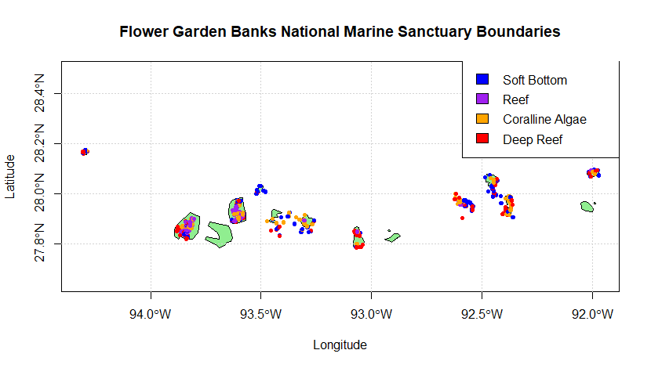
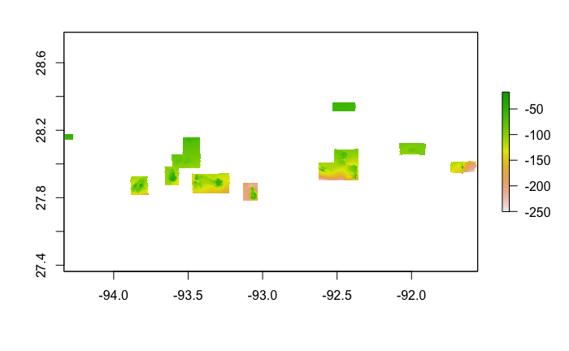

Improving habitat suitability models to understand how Mesophotic Coral Reef distribution will respond to climate change
Data (environmental and habitat or species locations)
Process Data (ArcPy in Python, R)
World Ocean Atlas and Database (NCEI) for region as .nc files
High-resolution multibeam bathymetry as ESRI grid files (USGS and FGB)
Habitat locations from Remotely Operated Vehicle photo analysis as many .csv files (FGBNMS collaborators)
Habitat locations
Bathymetry (5-m resolution) as GeoTiff (.tif)
Habitat locations: 20,000+ from four datasets
Coralline algae (after spatial thin): 1698
Scripts on Githubs:
@philipyang14 (me)
@marecotec (Andy Davies)

Slide 11
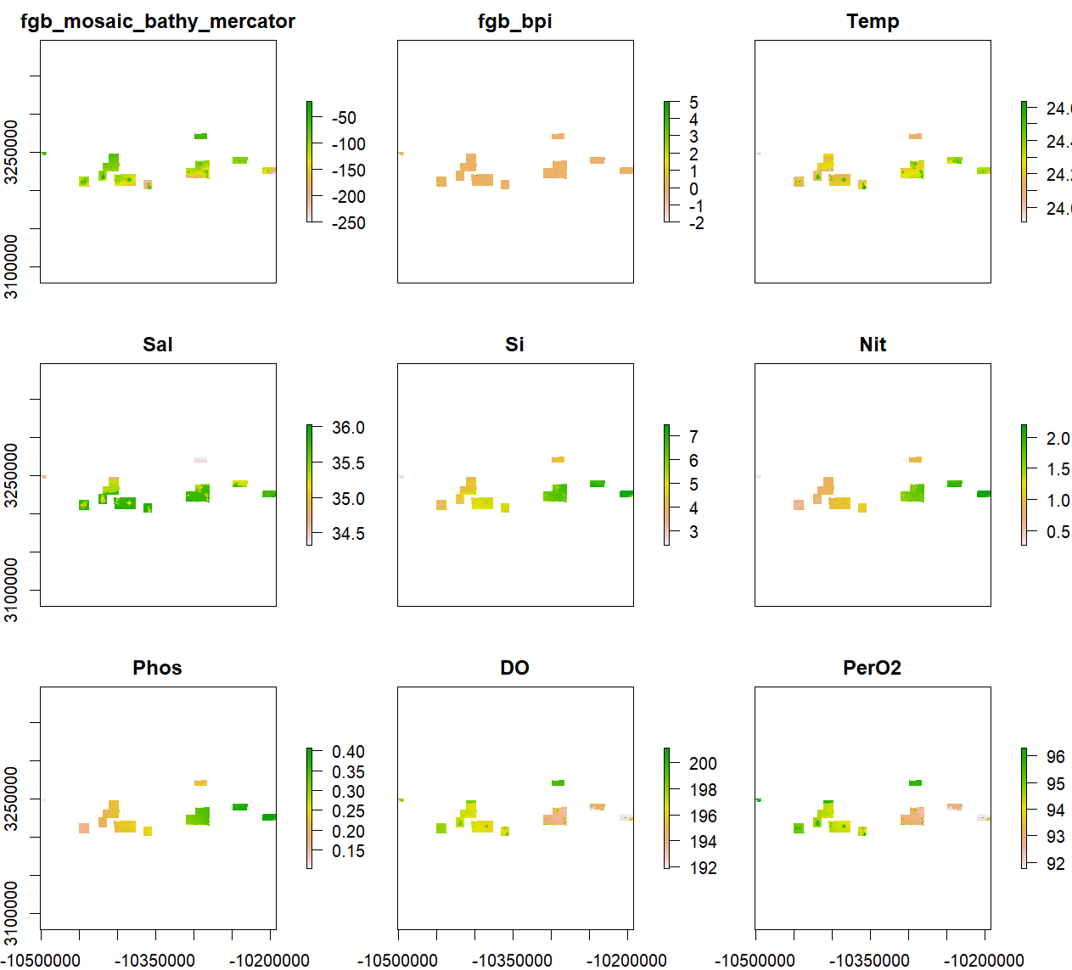
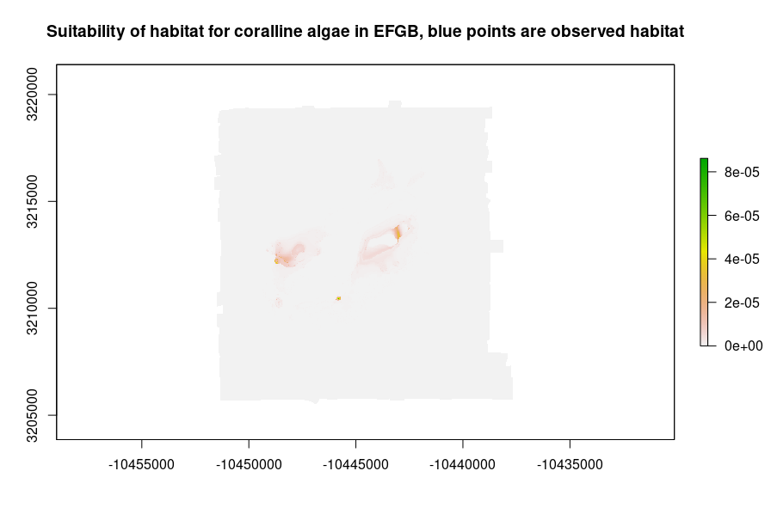
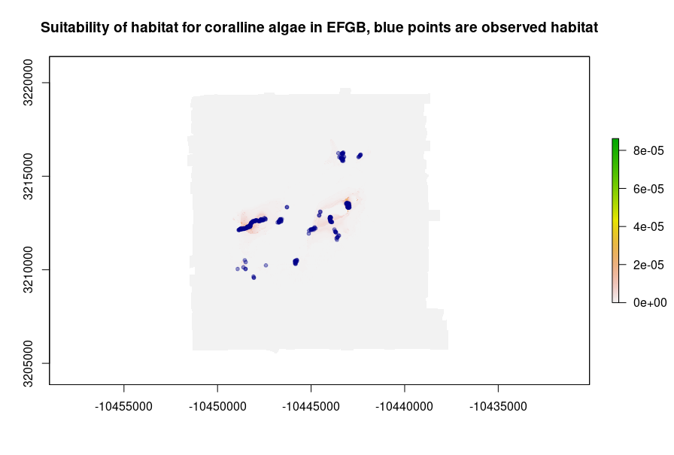
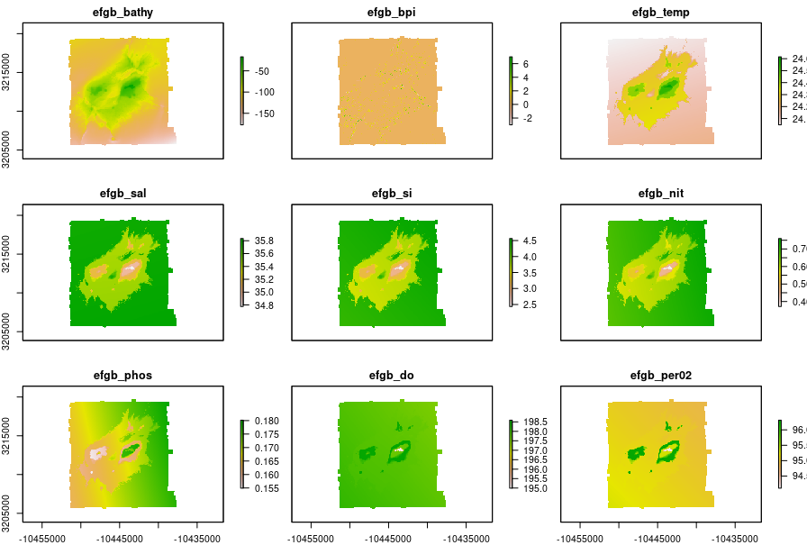
Improving habitat suitability models to understand how Mesophotic Coral Reef distribution will respond to climate change
Model script (R and Rstudio, we used MaxEnt model)
MaxEnt model run (on UNITY using OpenOnDemand and Slurm jobs)
Output: POTENTIAL suitable habitat
Whole extent: 980 million cells (taking 8+ hrs)
East Flower Garden Bank extent: 11 million cells (1.5 hrs)
East Flower Garden Bank
Coralline algae habitat locations: 322

Slide 12
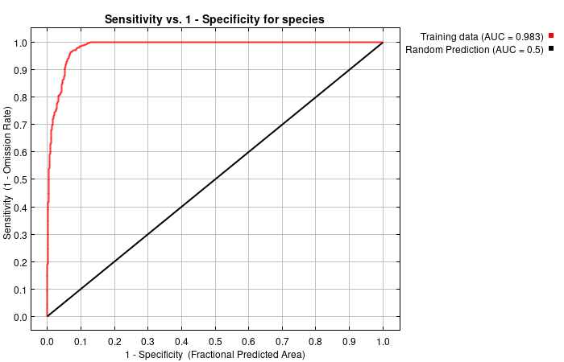
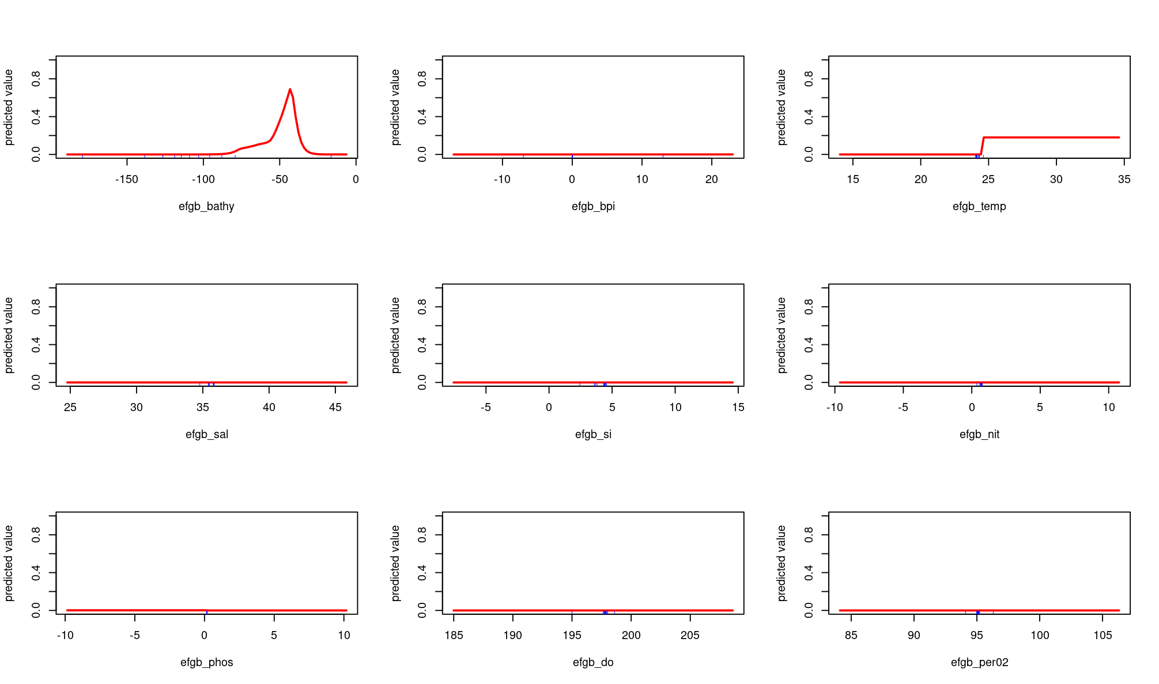
Improving habitat suitability models to understand how Mesophotic Coral Reef distribution will respond to climate change
MaxEnt model performance
Variable response curves
High AUC value –
100% predictions right: AUC = 1.0
100% predictions wrong: AUC = 0
Here AUC = 0.983

Slide 13
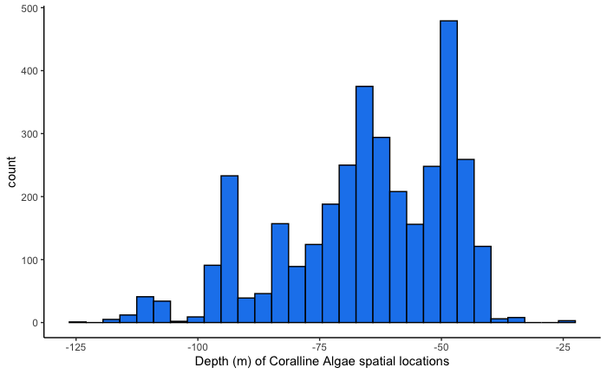
Improving habitat suitability models to understand how Mesophotic Coral Reef distribution will respond to climate change
MaxEnt model performance
Bathymetry response curve

Slide 14
Improving habitat suitability models to understand how Mesophotic Coral Reef distribution will respond to climate change
Learned:
How to build data layers for distribution models using different file types and python, ArcPy and R. Think about projections and spatial extents…
What computer clusters are and how to use UNITY (terminal, slurm jobs, and OpenOnDemand).
How computers work in general and how to take advantage of machines for ecological science in a changing world!

Slide 15
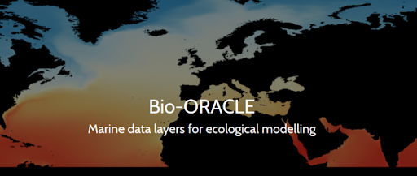
Planned publications
1. ”Habitat suitability models for mesophotic coral reefs and projected impacts of climate change in Flower Garden Banks National Marine Sanctuary, northwest Gulf of Mexico”
2. “Projected distribution shifts of mesophotic coral reefs across the world in different climate change scenarios”
Next steps: Use Bio-Oracle projected climate data layers to add climate change component. Currently have a summer URI Coastal Fellow intern working with me now!

Slide 16
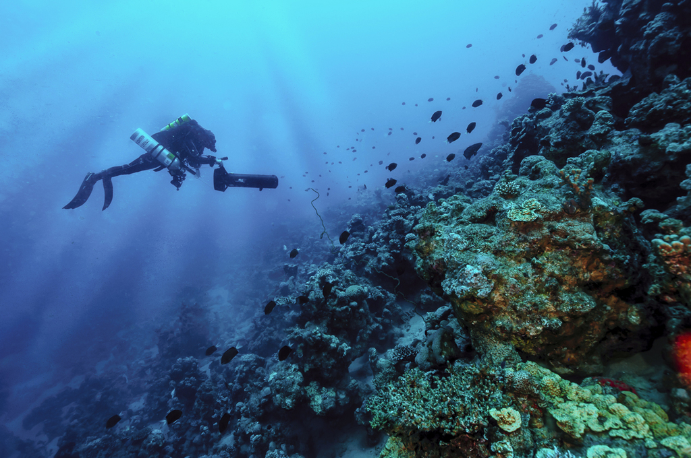

Thank you! Questions?
Gal Eyal, 75 m Eilat Israel. Credit: Dr. Yanothan Shaked
.
Notes:
75 m Eilat, Israel : Dr Yonathan Shaked

